Slide 1

Credit Card Fraud Detection
The Credit Card Fraud Detection Problem includes modeling past credit card transactions with the knowledge of the ones that turned out to be a fraud. This model is then used to identify whether a new transaction is fraudulent or not. The models to be used will be two unsupervised algorithms such as Local Outlier Factor and Isolation Forest Algorithm. The model will
also include a supervised learning algorithm which will be Random Forest and XGBoost . My aim here is to detect 100% of the fraudulent transactions while minimizing the incorrect fraud predictions.

Slide 2

This project aims to apply different algorithms & techniques on Credit Card Fraud data set and compare the results.
Measures used to compare those are Precision and Recall.
Measure like Accuracy is not good because the data set is highly unbalanced.
MAIN GOAL

Slide 3

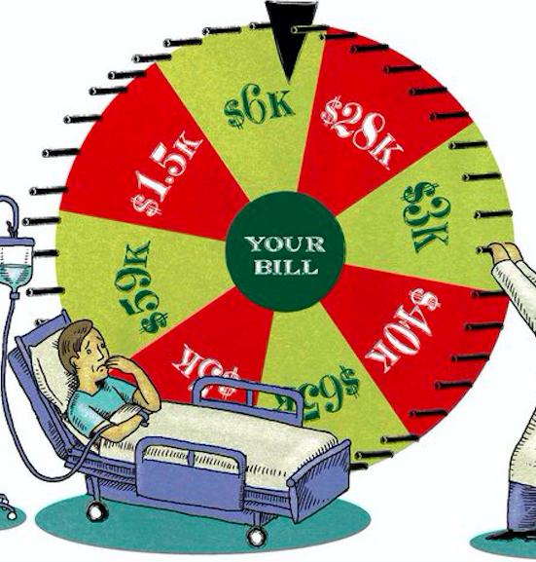
DATASET
The datasets contains transactions made by credit cards. This dataset presents transactions that occurred in two days, where we have 492 frauds out of 284,807 transactions. The dataset is highly unbalanced, the positive class (frauds) account for 0.172% of all transactions.
Due to confidentiality reasons, dataset available is not the original (raw) form but has been reduced using PCA. And the only features which have not been transformed with PCA are 'Time' and 'Amount’.
Weblink:
https://www.kaggle.com/mlgulb/creditcrdfraud/download

Slide 4
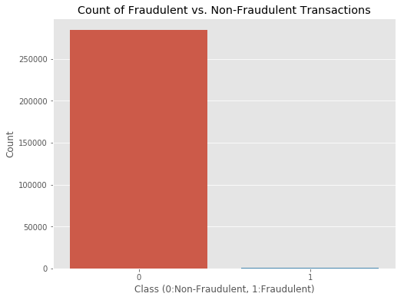
In the class distribution we want to know:
How many transactions are fraudulent and how many are not?
Well, as can be expected, most transactions are non-fraudulent. In fact, 99.83% of the transactions in this data set were not fraudulent while only 0.17% were fraudulent..

Slide 5
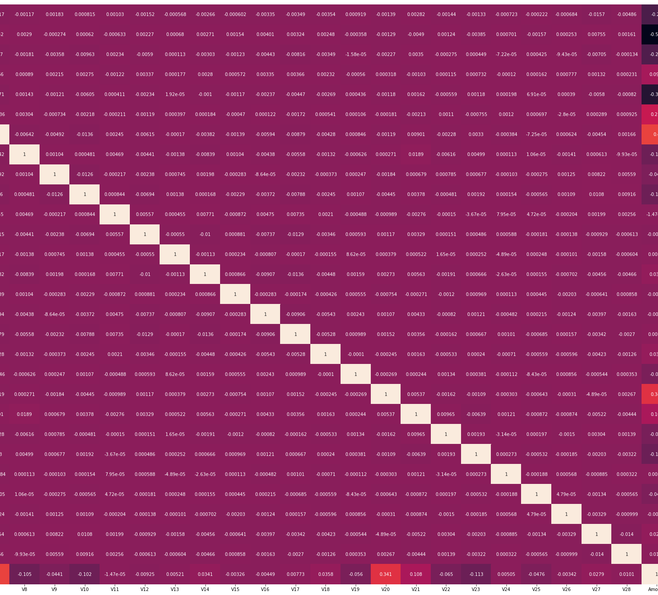
EDA
The purpose of EDA is to enhance our understanding of trends in the dataset without involving complicated machine learning models. From these column values, we can see that there are some very useful correlations present within our new dataset. For example, V2 and V5 are highly negatively correlated with the feature called Amount. We also see some correlation with V20 and Amount. This gives us a deeper understanding of the Data available to us.

Slide 6
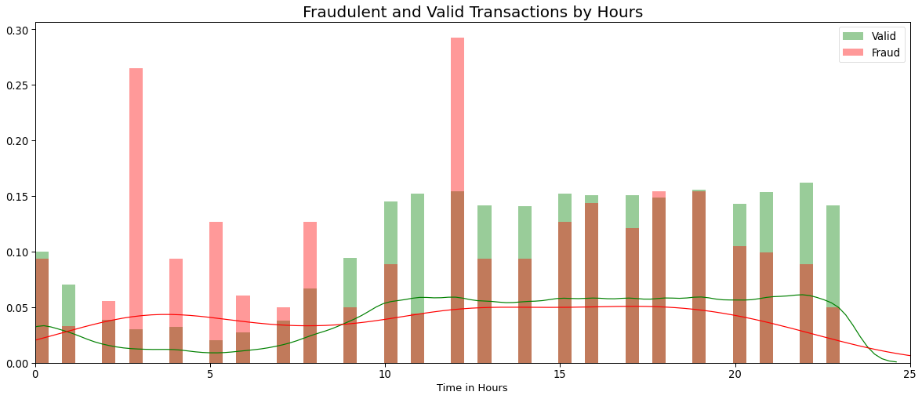
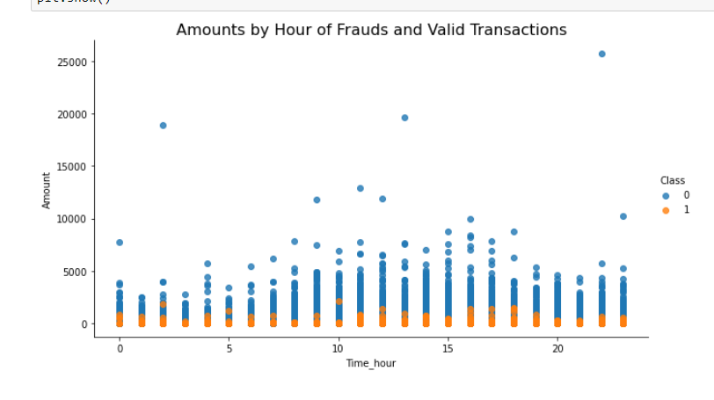
Exploring the distribution by Class types through hours
As we can see ,the most fraudulent transactions happening at 3, 12 o'clock. Fraudulent transactions of the same account didn't happen consecutively.
From the Scatter plots it is clearly visible that there are frauds only on the transactions which have transaction amount approximately less than 2500. Transactions which have transaction amount approximately above 2500 have no fraud.

Slide 7
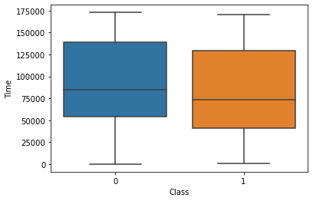
Let’s also plot a box chart of the distribution between fraud and not-fraud for easier viewing.
By looking at the box plot we can say that both fraud & valid transactions occur throughout time and there is no distinction between them.

Slide 8
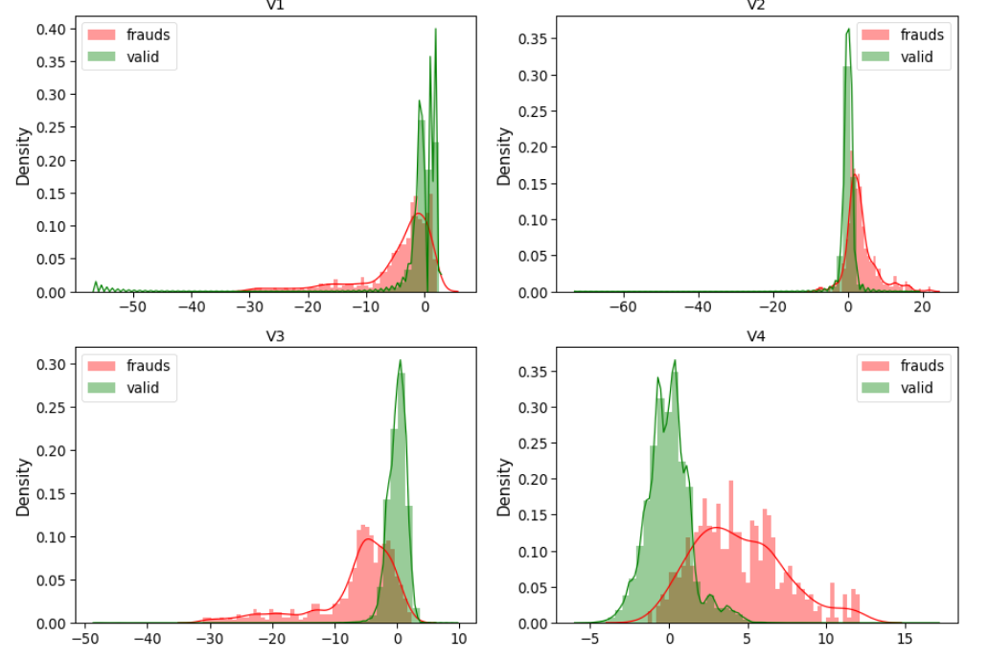
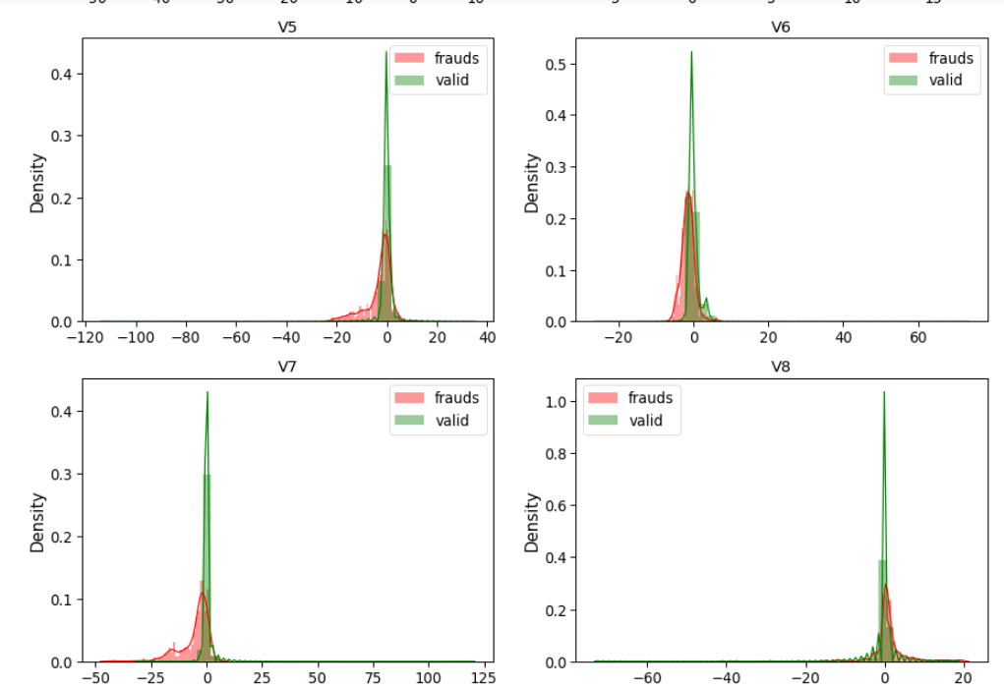
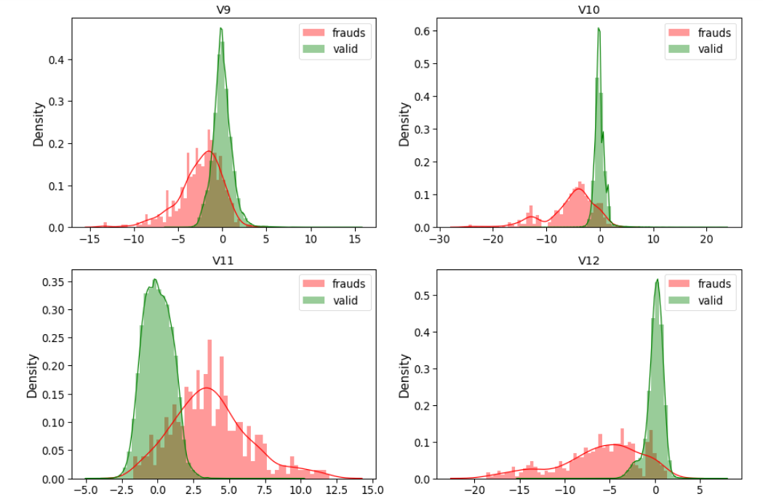
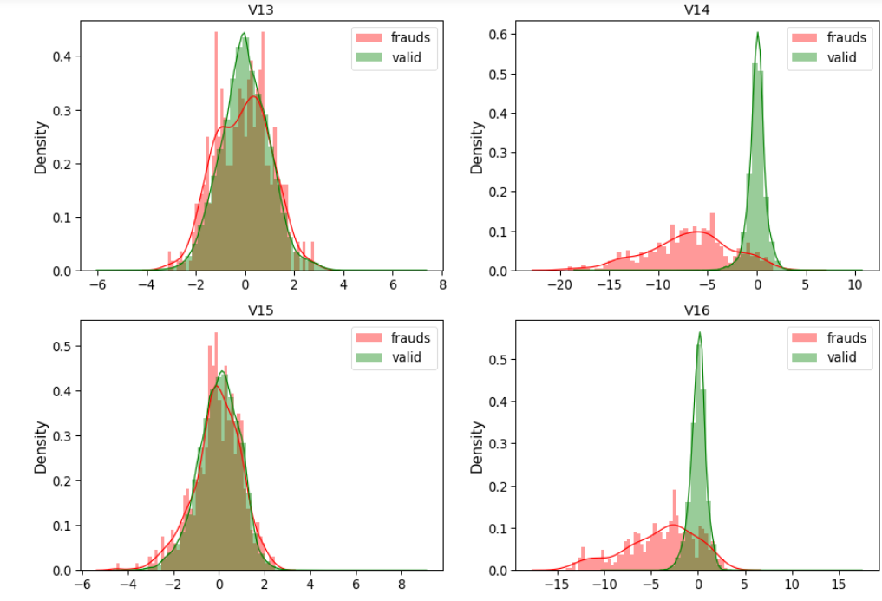
Visualizing all the features from a dataset
On graphs
For some of the features we can observe a good selectivity in terms of distribution for the two values of Class: V4, V11 have clearly separated distributions for Class values 0 and 1(we have portion of data in the right side, skew for fraud in the right and for valid is 0 ). V12, V14, V18 are partially separated, V1, V2, V3, V10 have a quite distinct profile(because the most values cluster on the right and left side). .V15,V22, V25, V26, V28 have similar profiles(they are overlap, impossible to make comparisons for two values of class.)

Slide 9
The purpose of the data preprocessing stage is to minimize potential error in the model as much as possible. after that we start To standardize the numeric features and apply scaler to the testing set.
Data preprocessing

Slide 10
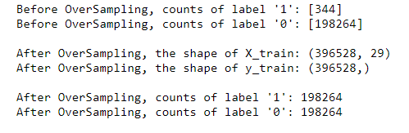
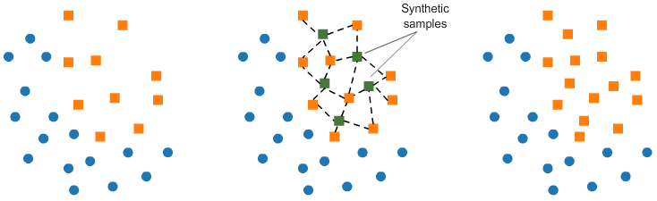
Increase successful detections with data resampling
Oversampling(SMOTE) :
It should be clear that SMOTE has balanced our data completely, and that the minority class is now equal in size to the majority class.

Slide 11
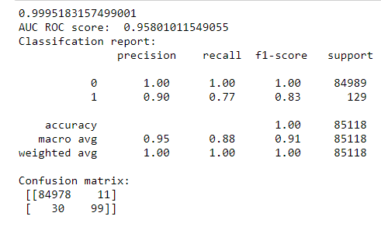
Modeling
we are using XGBoost, Isolation Forest, RandomForest, Local Outlier Factor to perform my predictions. In this project I would like to compare 2 machine learning method:
Random Forest
XGBoost
The Random Forest classification report is :
With the Random Forest Classifier with SMOTE Model, we have:
The model is able to predict only 92% of fraudulent transactions .(precision score)
84978 transactions classified as valid and were actually valid(True Positive)(here 84980 are the number of CORRECTLY PREDICTED safe cases).
11 transactions classified as fraud but that were really valid(type 1 error)( here 9 are the number of MISCLASSIFIED safe cases. Hence 9 safe cases were misclassified as a fraud. This is potentially less dangerous as it’s better to stop some safe transactions with the slightest chance of fraud.;
30 transactions classified as valid, but which were fraud (type 2 error)(here 30 are the number of MISCLASSIFIED fraud cases. hence 30 fraud cases were misclassified as safe. This is very dangerous because we are letting the fraud cases pass through. This can cause a huge loss to the organization.;
99 transactions classified as fraud and were actually fraud.
we have 129 transactions as fraud.
Look at the precision, recall, f1_score .The accuracy looks good.
The machine learning algorithms for detecting credit card fraud are highly efficient, but there are still gaps to close. One of the biggest problems is the occurrence of False Positives, that is when the algorithm incorrectly detects a fraud. Thus, we are always searching for ways to shrink even more that 3% mark of False Positives.

Slide 12
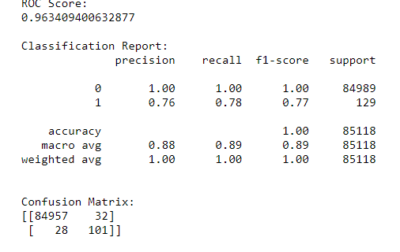
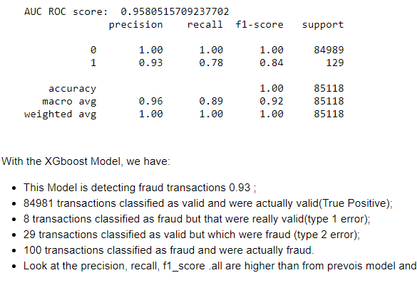
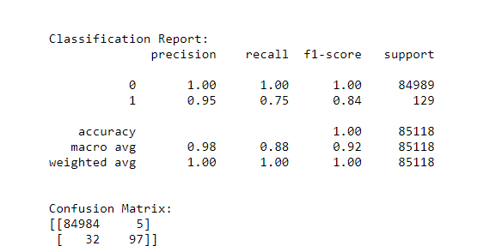
XGBOOST
XGBoost has an inherent ability to handle missing values.
Let’s see if we can improve their performance through hyperparameter optimization:
I want to use GridSearchCV for hyperparameter tuning. In this approach machine learning is an evaluated for a range of hyperparameter values. but my result didn’t improve.
Ensemble methods
To improve my prediction performance, I’ve decided to use ensemble method like Voting classifier. I’ve combined two algorithms into one model with the Voting Classifier and improved overall performance and detected more fraud.

Slide 13
COCLUSION AND FUTURE ENHANCEMENTS:
COCLUSION
4 kind of models of machine learning has been used to examine their performance on a dataset which contains real world transaction data. Comparison between these algorithms(LOF, IF, RF, XGB) helped us to decide Random Forest and XGB which turned out to be both accurate and cost effective at the same time. While we couldn't reach out goal of 100% accuracy in fraud detection, we did end up creating a system that can, with enough time and data, get very close to that goal. As with any such project, there is some room for improvement here.
FUTURE ENHANCEMENTS
This model can further be improved with the addition of more algorithms into it. However, the output of these algorithms needs to be in the same format as the others.
More room for improvement can be found in the dataset. As demonstrated before, the precision of the algorithms increases when the size of dataset is increased. Hence, more data will surely make the model more accurate in detecting frauds and reduce the number of false positives.

